Slide 1
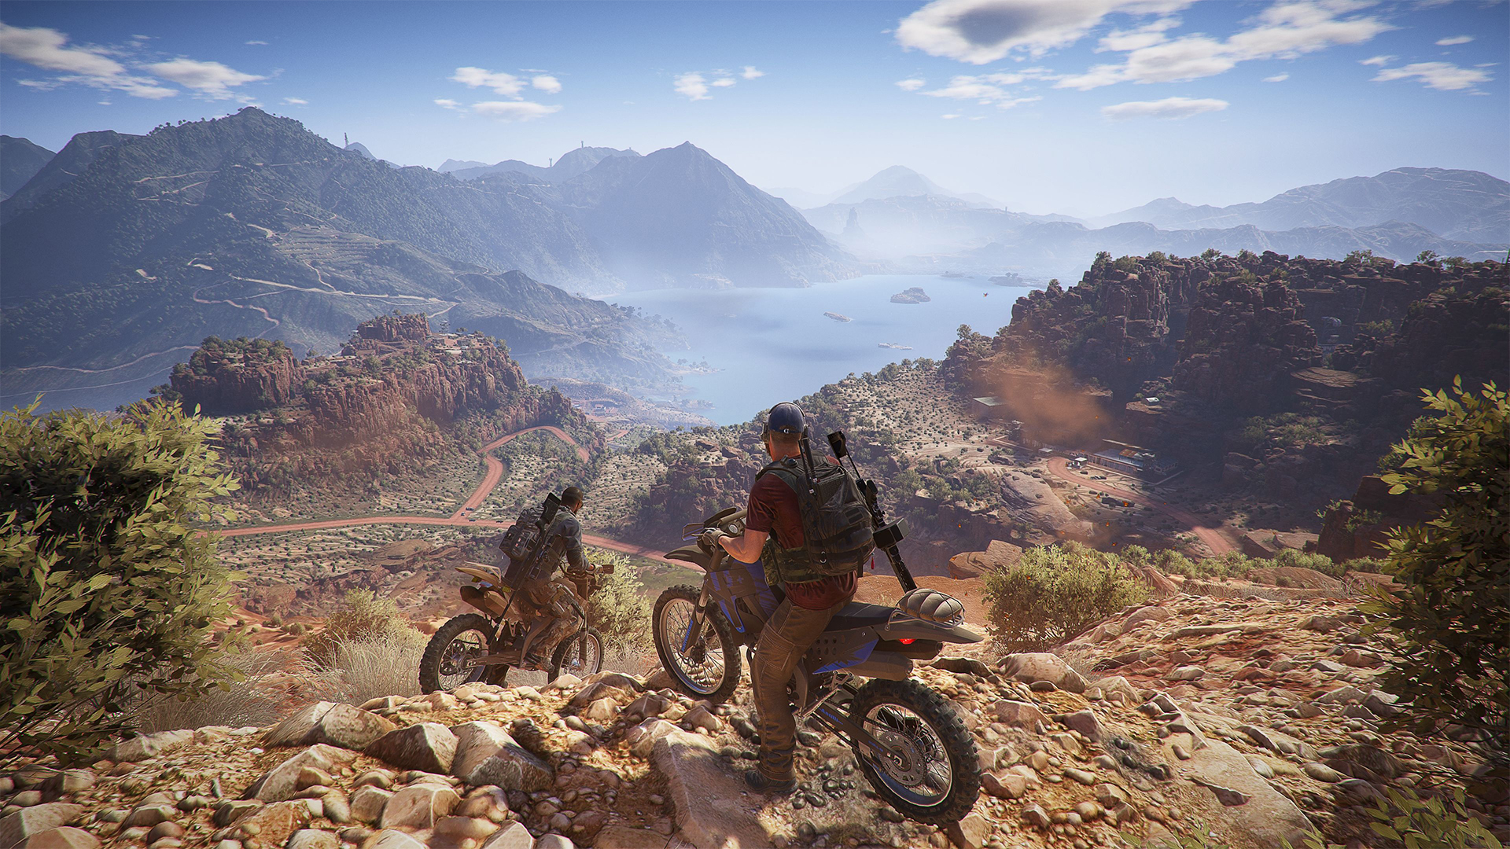
GAME PROGRAMMING IN C++
2020
Notes:
Kratak uvod u render i u to da ćemo danas da prilažemo sliku na ekranu, a posle toga pričati o teoriji renderinga

Slide 2
Biblioteke za razvoj igara
Na našu sreću, postoje ljudi koji su i taj korak napravili umesto nas
https://github.com/Calinou/awesome-gamedev#programming-frameworks-and-libraries
SDL, SFML, pyGame, LÖVE, GLFW, Three.js, bgfx
I dalje zahtevaju dosta programiranja, ne treba ih pomešati sa Unity i Unreal-om

Slide 3
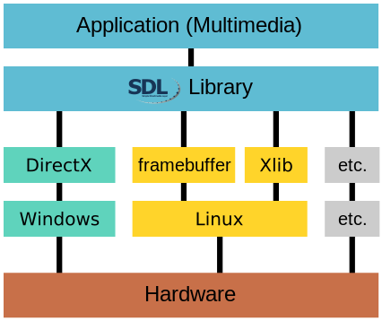
SDL2
Notes:
GDI, DirectX

Slide 4


SDL2 podsistemi
Basics
Initialization and Shutdown, Configuration Variables, Error Handling, Log Handling
Video
Display and Window Management, surface functions, rendering acceleration, etc.
Input Events
Event handling, Support for Keyboard, Mouse, Joystick and Game controller
Audio
SDL_audio.h implements Audio Device Management, Playing and Recording
Threads
multi-threading: Thread Management, Thread Synchronization Primitives, Atomic OperationsFile Abstraction
Notes:
SDL_image — support for multiple image formats^{[20]}
SDL_mixer — complex audio functions, mainly for sound mixing^{[21]}
SDL_net — networking support^{[22]}
SDL_ttf — TrueType font rendering support^{[23]}
SDL_rtf — simple Rich Text Format rendering^{[24]}
Napisan u Cu, sa podrškom za 20 programskih jezika

Slide 5
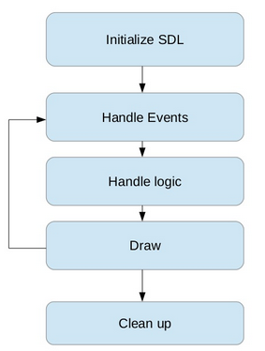
Struktura SDL aplikacija
https://www.slideshare.net/EricBasile/sdl2-gamedevelopment-vt-code-camp

Slide 6
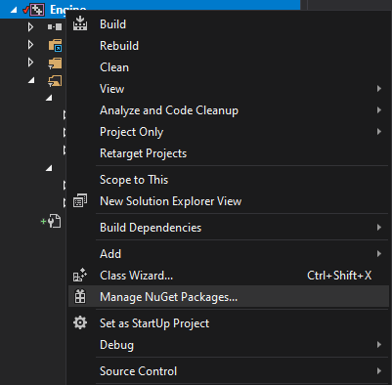
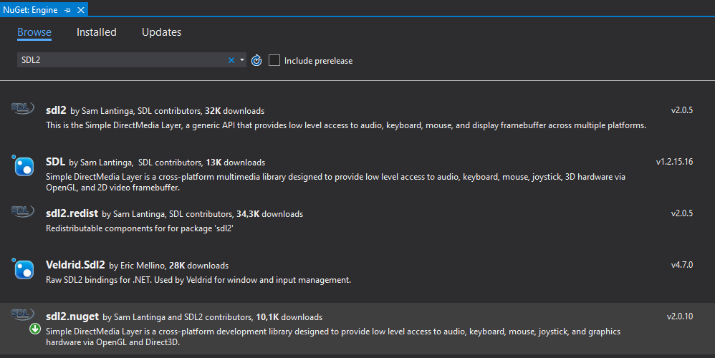
Dodavanje SDL2 u projekat
isto i za sdl2_image.nuget

Slide 7
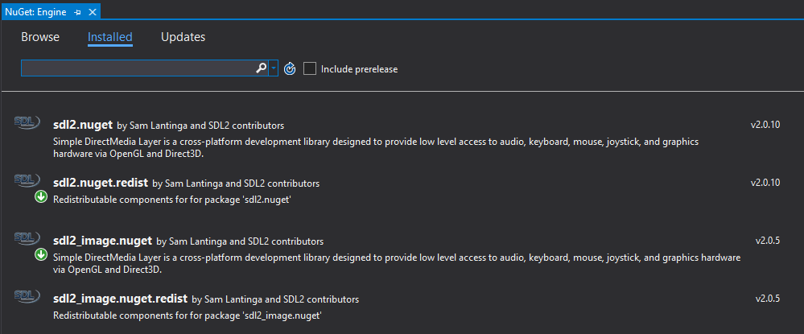
Dodavanje SDL2 u projekat
Notes:
Proveravamo da li je sve dodato kako treba

Slide 8
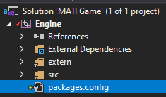
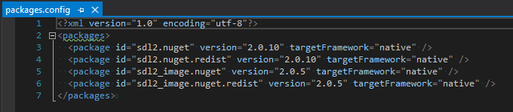
Dodavanje SDL2 u projekat
Notes:
Proveravamo da li je sve dodato kako treba

Slide 9
Korišćenje SDL2
Mi ćemo koristiti samo za render
http://lazyfoo.net/tutorials/SDL/
Pošto je C biblioteka, ne možemo da koristimo RAII

Slide 10
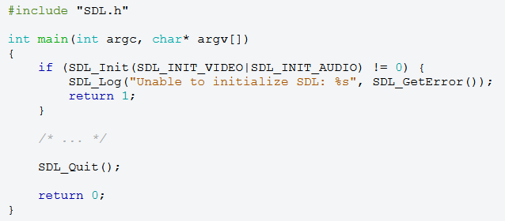
Korišćenje SDL2
Use this function to initialize the SDL library. This must be called before using most other SDL functions.
SDL_INIT_TIMER
SDL_INIT_AUDIO
SDL_INIT_VIDEO
SDL_INIT_JOYSTICK
SDL_INIT_HAPTIC
SDL_INIT_GAMECONTROLLER
SDL_INIT_EVENTS
SDL_INIT_EVERYTHING
SDL_INIT_NOPARACHUTE
https://wiki.libsdl.org/

Slide 11
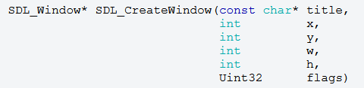
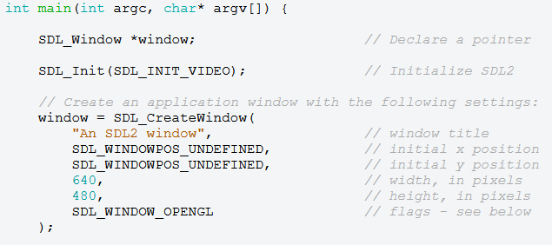
Korišćenje SDL2
Use this function to create a window with the specified position, dimensions, and flags.
title | the title of the window, in UTF-8 encoding
x | the x position of the window, SDL_WINDOWPOS_CENTERED, or SDL_WINDOWPOS_UNDEFINED
y | the y position of the window, SDL_WINDOWPOS_CENTERED, or SDL_WINDOWPOS_UNDEFINED
w | the width of the window, in screen coordinates
h | the height of the window, in screen coordinates
flags | 0, or one or more SDL_WindowFlags OR'd together; see Remarks for details
https://wiki.libsdl.org/
Notes:
SDL_WINDOW_FULLSCREEN
fullscreen window
SDL_WINDOW_FULLSCREEN_DESKTOP
fullscreen window at the current desktop resolution
SDL_WINDOW_OPENGL
window usable with OpenGL context
SDL_WINDOW_VULKAN
window usable with a Vulkan instance
SDL_WINDOW_HIDDEN
window is not visible
SDL_WINDOW_BORDERLESS
no window decoration
SDL_WINDOW_RESIZABLE
window can be resized
SDL_WINDOW_MINIMIZED
window is minimized
SDL_WINDOW_MAXIMIZED
window is maximized
SDL_WINDOW_INPUT_GRABBED
window has grabbed input focus
SDL_WINDOW_ALLOW_HIGHDPI
window should be created in high-DPI mode if supported (>= SDL 2.0.1)

Slide 12
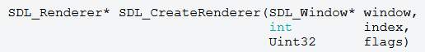
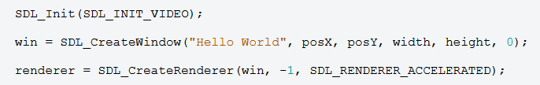
Korišćenje SDL2
Use this function to create a 2D rendering context for a window.
window | the window where rendering is displayed
index | the index of the rendering driver to initialize, or -1 to initialize the first one supporting the requested flags
flags | 0, or one or more SDL_RendererFlags OR'd together; see Remarks for details
https://wiki.libsdl.org/
Notes:
SDL_RENDERER_SOFTWARE
the renderer is a software fallback
SDL_RENDERER_ACCELERATED
the renderer uses hardware acceleration
SDL_RENDERER_PRESENTVSYNC
present is synchronized with the refresh rate
SDL_RENDERER_TARGETTEXTURE
the renderer supports rendering to texture

Slide 13
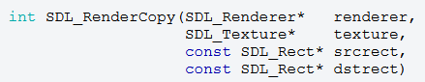
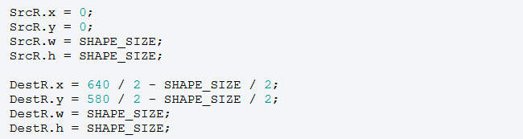
Korišćenje SDL2
Use this function to copy a portion of the texture to the current rendering target.
renderer | the rendering context
texture | the source texture; see Remarks for details
srcrect | the source SDL_Rect structure or NULL for the entire texture
dstrect | the destination SDL_Rect structure or NULL for the entire rendering target; the texture will be stretched to fill the given rectangle
Use this function to update the screen with any rendering performed since the previous call.
https://wiki.libsdl.org/
Notes:
SDL_RENDERER_SOFTWARE
the renderer is a software fallback
SDL_RENDERER_ACCELERATED
the renderer uses hardware acceleration
SDL_RENDERER_PRESENTVSYNC
present is synchronized with the refresh rate
SDL_RENDERER_TARGETTEXTURE
the renderer supports rendering to texture

Slide 14
Naš RenderSystem
Init()
Pravi SDL_Window
Pravi SDL_Renderer
Update()
Obriše sve sa ekrana
Poziva SDL_Renderer za iscrtavanje svake slike u framebuffer
Prikazuje framebuffer na ekran
Shutdown()
Uništava SDL_Renderer i SDL_Window

Slide 15
Naš RenderSystem
Init()
Pravi Engine::Window – Wrapper oko SDL_Window
Pravi Engine::Renderer – Wrapper oko SDL_Renderer
Update()
Obriše sve sa ekrana
Poziva Engine::Renderer za iscrtavanje svake slike u framebuffer
Prikazuje framebuffer na ekran
Shutdown()
Uništava Engine::Renderer i Engine::Window

Slide 16
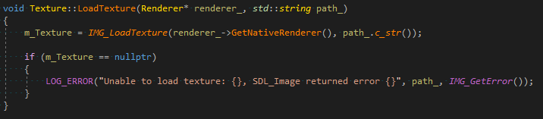
Naš RenderSystem
Slike!
Engine::Texture -> wrapper oko SDL_Texture
Učitavaju se direktno sa diska pomoću SDL_Image pomoćne biblioteke i IMG_LoadTexture()

Slide 17
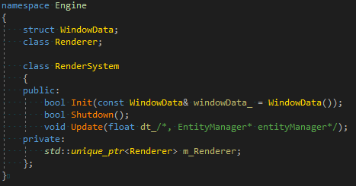
Naš RenderSystem

Slide 18
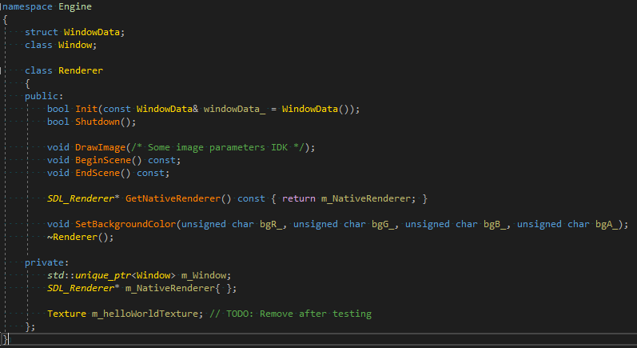
Naš RenderSystem

Slide 19
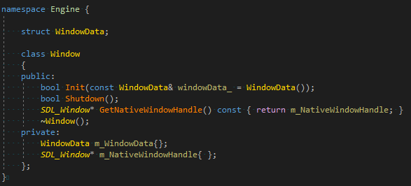
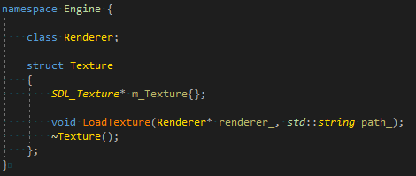
Naš RenderSystem

Slide 20
Zadatak
Engine::Window
Napraviti SDL_Window
Engine::Render
Napraviti Engine::Window, napraviti SDL_Renderer
Učitati jednu sliku (hello_world.jpg u root-u repozitorijuma)
Prikazati je na ekranu (Koristeći SDL_RenderCopy)
Pomoć
http://lazyfoo.net/tutorials/SDL/02_getting_an_image_on_the_screen/index.php
https://wiki.libsdl.org/SDL_Init

Slide 21
A sad teorija
Hvala na strpljenju
Notes:
Ovo je realno na sledećem dvočasu

Slide 22
Rendering
Our ability to draw graphics on the screen – TheCherno
Rendering or image synthesis is the automatic process of generating a photorealistic or non-photorealistic image from a 2D or 3D model or scene by means of computer programs – Wikipedia
Može biti:
Offline / Pre-rendered - filmovi
Real-time i interactive - u igrama
Dešava se na zasebnom čipu – GPU
Notes:
Dešava se na zasebnom čipu – GPU, koji je specijalizovan za ovaj posao – omogućava paralelizaciju i specijalizovan je konkretne matematičke operacije koje se često koriste u renderingu

Slide 23
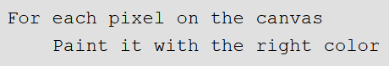
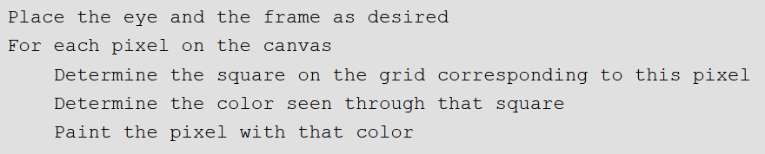
Rendering
Algoritam za rendering scene
Malo detaljnije

Slide 24
Osnove
Scena
Skup 3D oblika prisutnih u prostoru
Kamera
Postavljena tako da se scena hvata iz željenog ugla i udaljenosti
Izvori svetla
Osvetljavaju prostor i objekte i čiji virtuelni fotoni na kraju osvetljavaju piksele kamere
Jason Gregory. 2014. Game Engine Architecture
Notes:
• A virtual scene is described, usually in terms of 3D surfaces represented
in some mathematical form.
• A virtual camera is positioned and oriented to produce the desired view
of the scene. Typically the camera is modeled as an idealized focal point,
with an imaging surface hovering some small distance in front of it, composed
of virtual light sensors corresponding to the picture elements (pixels)
of the target display device.
• Various light sources are defined. These sources provide all the light rays
that will interact with and reflect off the objects in the environment and
eventually find their way onto the image-sensing surface of the virtual
camera.
• The visual properties of the surfaces in the scene are described. This
defines how light should interact with each surface.
• For each pixel within the imaging rectangle, the rendering engine calculates
the color and intensity of the light ray(s) converging on the virtual
camera’s focal point through that pixel. This is known as solving the
rendering equation (also called the shading equation).
The primary goal is usually photorealism, although some games aim for a more
stylized look (e.g., cartoon, charcoal sketch, watercolor and so on).
As such, rendering engineers and artists usually attempt
to describe the properties of their scenes as realistically as possible and to
use light transport models that match physical reality as closely as possible.
Within this context, the gamut of rendering technologies ranges from techniques
designed for real-time performance at the expense of visual fidelity, to
those designed for photorealism, but which are not intended to operate in real
time.

Slide 25
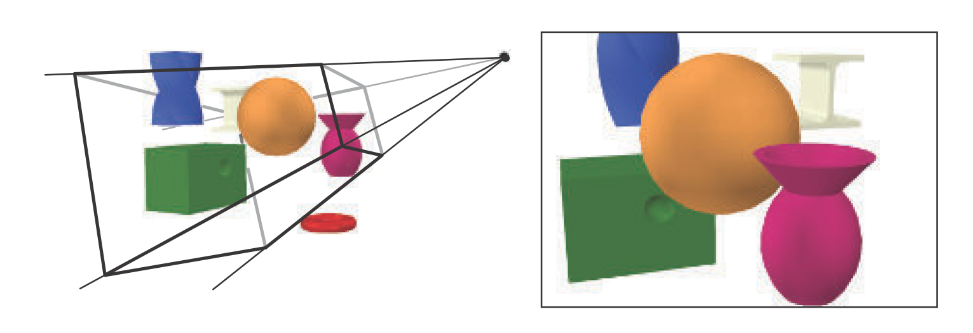
Osnove
Tomas Akenine-Moller, Tomas Moller, and Eric Haines. 2002. Real-Time Rendering (2nd. ed.)

Slide 26
Osnove
Vizuelna svojstva 3D oblika prisutnih na sceni
Shader
Programi koji se izvršavaju na GPU
Za svaki piksel kamere, izračunavaju se boja i intenzitet svetlosnih zraka koji konvergiraju u tu tačku
I sve ovo 30/60/144 puta po sekundi
Jason Gregory. 2014. Game Engine Architecture
Notes:
• A virtual scene is described, usually in terms of 3D surfaces represented
in some mathematical form.
• A virtual camera is positioned and oriented to produce the desired view
of the scene. Typically the camera is modeled as an idealized focal point,
with an imaging surface hovering some small distance in front of it, composed
of virtual light sensors corresponding to the picture elements (pixels)
of the target display device.
• Various light sources are defined. These sources provide all the light rays
that will interact with and reflect off the objects in the environment and
eventually find their way onto the image-sensing surface of the virtual
camera.
• The visual properties of the surfaces in the scene are described. This
defines how light should interact with each surface.
• For each pixel within the imaging rectangle, the rendering engine calculates
the color and intensity of the light ray(s) converging on the virtual
camera’s focal point through that pixel. This is known as solving the
rendering equation (also called the shading equation).
The primary goal is usually photorealism, although some games aim for a more
stylized look (e.g., cartoon, charcoal sketch, watercolor and so on).
As such, rendering engineers and artists usually attempt
to describe the properties of their scenes as realistically as possible and to
use light transport models that match physical reality as closely as possible.
Within this context, the gamut of rendering technologies ranges from techniques
designed for real-time performance at the expense of visual fidelity, to
those designed for photorealism, but which are not intended to operate in real
time.

Slide 27
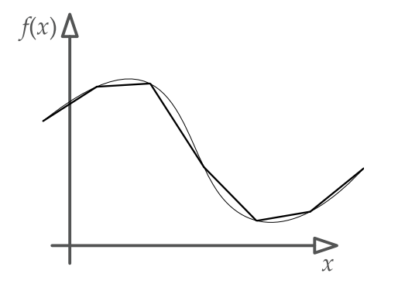
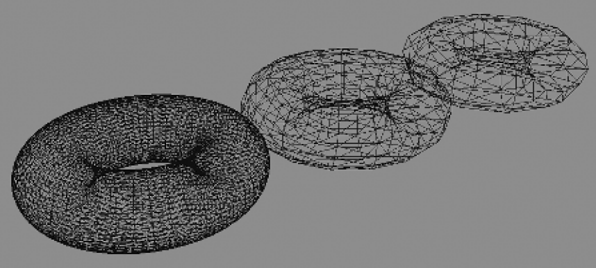
Oblici
U stvari su površi predstavljene parametarskim jednačinama u 3D prostoru
U video igrama se uglavnom predstavljaju aproksimacijama sastavljenih od trouglova – triangle mesh
Jason Gregory. 2014. Game Engine Architecture
Notes:
• The triangle is the simplest type of polygon. Any fewer than three vertices,
and we wouldn’t have a surface at all.
• A triangle is always planar.
• Triangles remain triangles under most kinds of transformations, including
affine transforms and perspective projections.
• Virtually all commercial graphics-acceleration hardware is designed around tri-
angle rasterization.
One problem with the kind of triangle mesh used in games is that its level
of tessellation is fixed by the artist when he or she creates it. Fixed tessellation
can cause an object’s silhouette edges to look blocky. This can be helped
by creating a chain of alternate versions of each triangle
mesh, each known as a level of detail (LOD). The first LOD, often called LOD 0,
represents the highest level of tessellation; it is used when the object is very
close to the camera. Subsequent LODs are tessellated at lower and lower res-
olutions

Slide 28
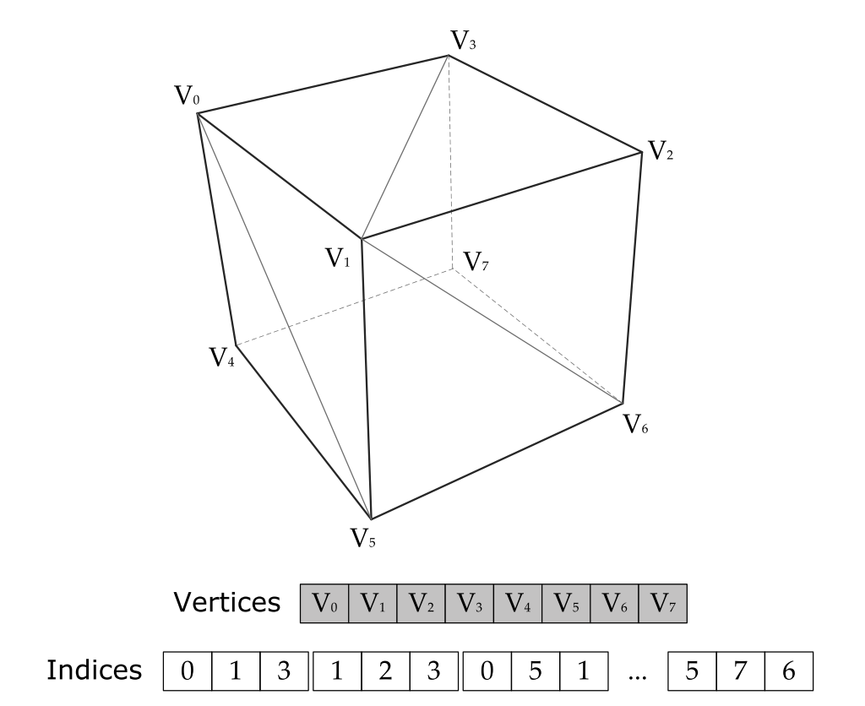
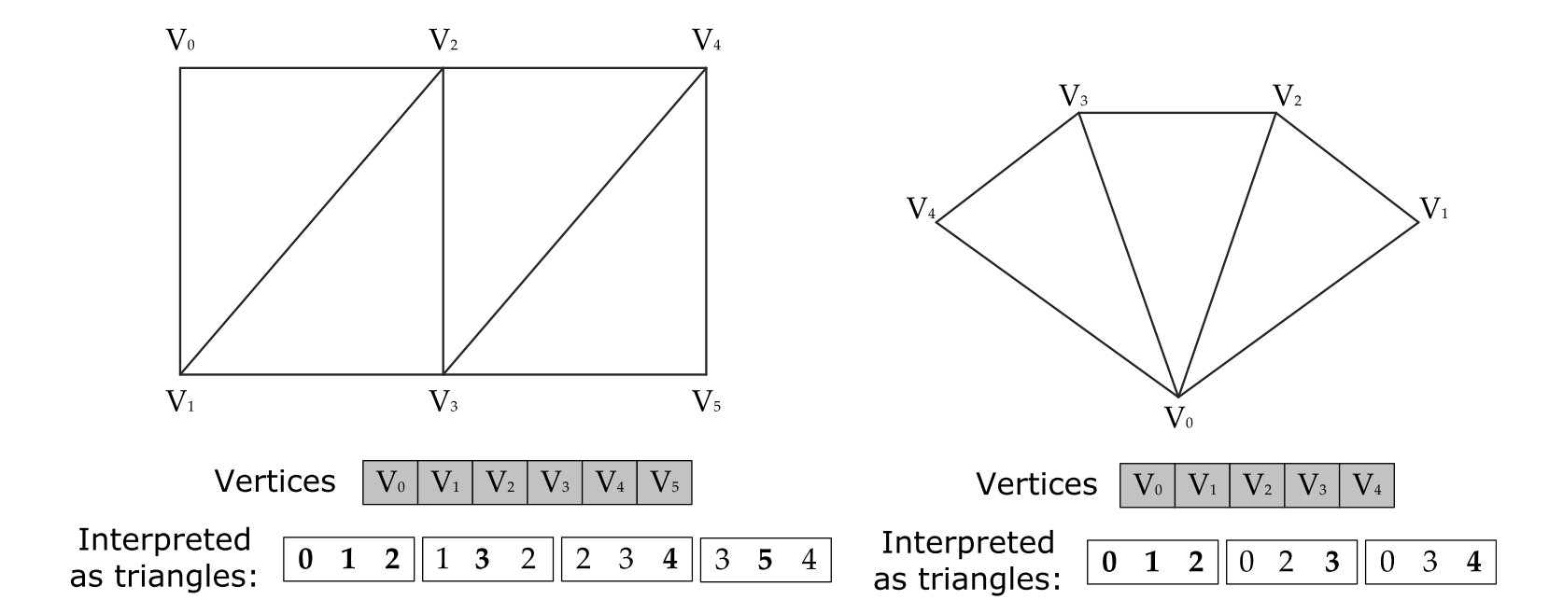
Trouglovi
Definisani su pozicijom svojih temena (vertices) i normalom
Svako teme pored pozicije i normale može imati razna druga svojstva
Pakuju se u liste, linije i lepeze da bi definisali mesh
Jason Gregory. 2014. Game Engine Architecture
Notes:
Vertex Buffer
Index Buffer
Vector3 m_p; // position
Color4 m_d; // diffuse color and translucency
Color4 m_S; // specular color
F32 m_uv0[2]; // first set of tex coords
F32 m_uv1[2]; // second set of tex coords
U8 m_k[4]; // four joint indices, and...
F32 m_w[3]; // three joint weights, for
// skinning

Slide 29
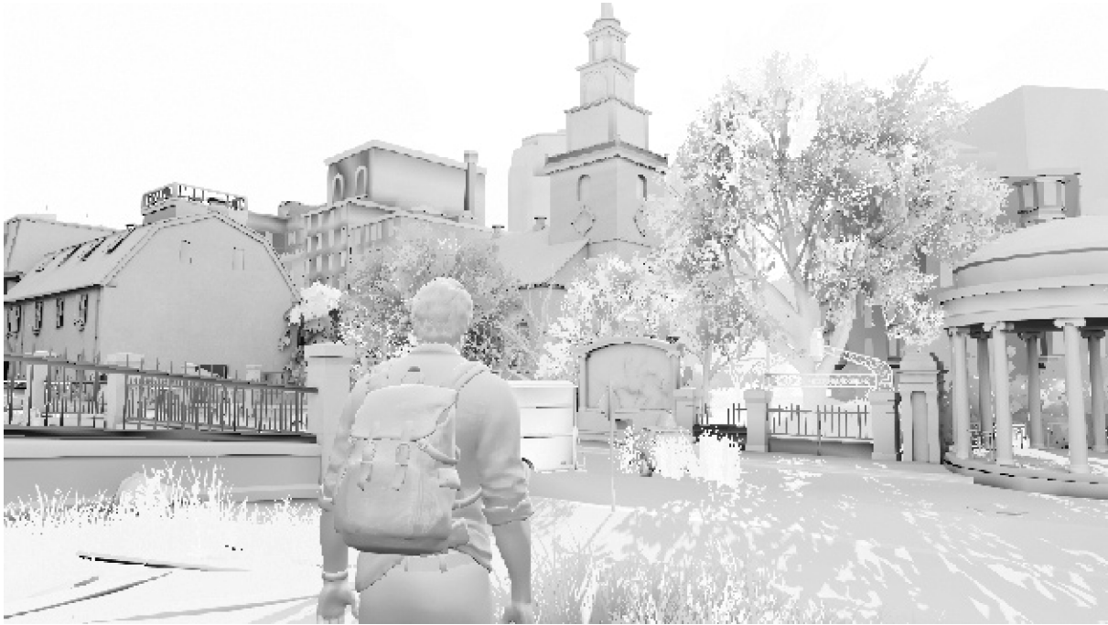
Notes:
A scene from The Last of Us: Remastered (© 2014/™ SIE. Created and developed byNaughty Dog, PlayStation 4) rendered without textures.
Jason Gregory. 2014. Game Engine Architecture

Slide 30
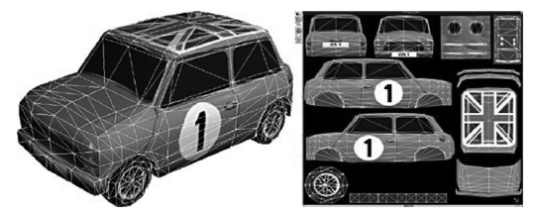
Teksture
Koristimo ih da ne bismo za svaki vertex direktno definisali karakteristike
Predstavljaju bitmape koje se, nalik tetovažama iz žvaka, lepe na 3D oblik – Diffuse map
Zatim je potrebno mapirati koordinate teksture na svaki vertex
Druge vrste tekstura: Normal maps, gloss maps, environment maps, opacity maps, LUTs
Jason Gregory. 2014. Game Engine Architecture
Notes:
When triangles are relatively large, specifying surface properties on a per-
vertex basis can be too coarse-grained. Linear attribute interpolation isn’t al-
ways what we want, and it can lead to undesirable visual anomalies.
But a texture can contain other kinds of visual surface properties
as well as colors. And a texture needn’t be projected onto a mesh—for exam-
ple, a texture might be used as a stand-alone data table.
Other types of textures are used in computer graphics as well, including
normal maps (which store unit normal vectors at each texel, encoded as RGB
values), gloss maps (which encode how shiny a surface should be at each texel),
environment maps (which contain a picture of the surrounding environment
for rendering refl ections) and many others.

Slide 31
Materijal
Kompletan opis vizuelne reprezentacije mesh-a
Teksture
Shaderi
Parametri shader-a
U paru, mesh i materijal zajedno sadrže sve informacije potrebne za render objekta

Slide 32
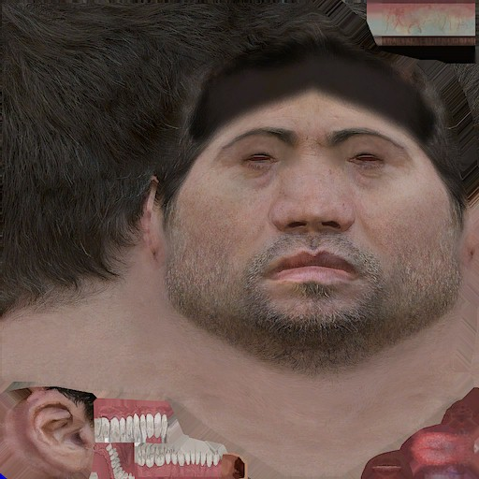
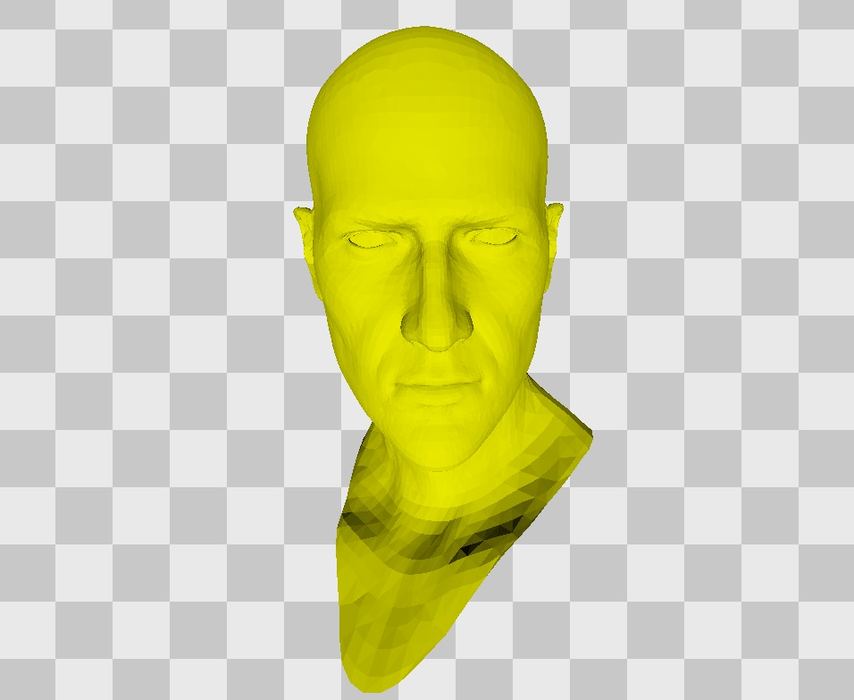
https://renderdoc.org/blog/Graphics-in-Plain-Language/
Notes:
Ovaj deo nije detaljan jer je uvek sakriven kapom

Slide 33
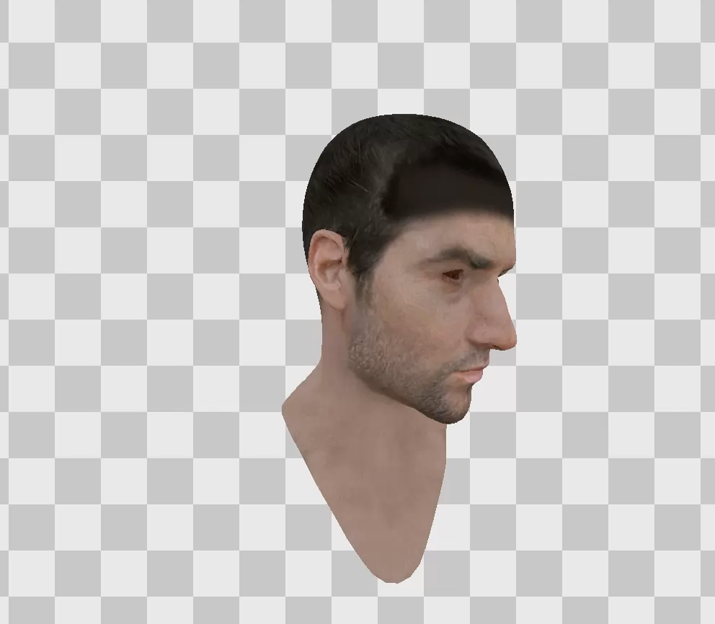
https://renderdoc.org/blog/Graphics-in-Plain-Language/

Slide 34
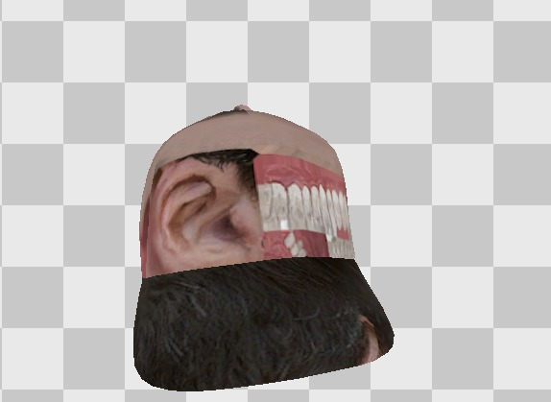
https://renderdoc.org/blog/Graphics-in-Plain-Language/

Slide 35
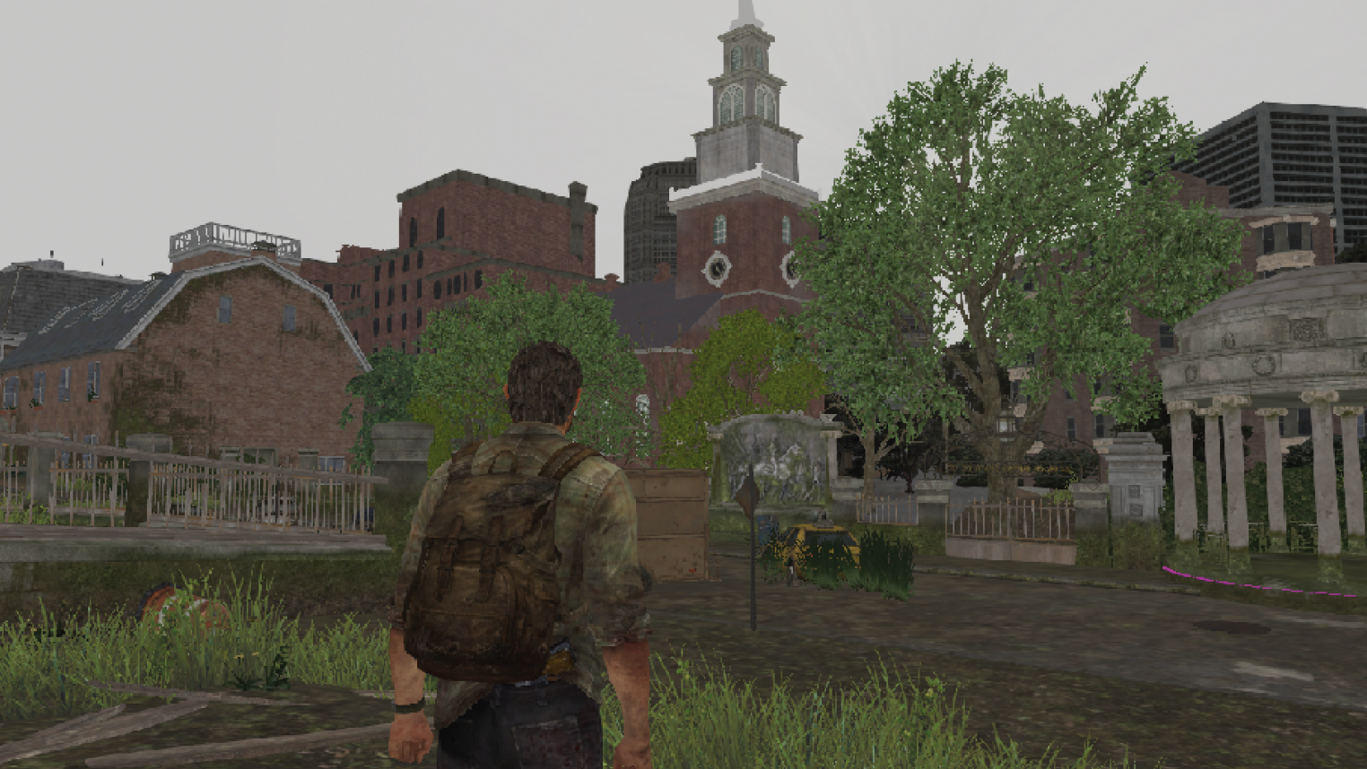
Notes:
Plate XVI. The same scene from The Last of Us: Remastered (© 2014/™ SIE. Created and developed by Naughty Dog, PlayStation 4) with only diffuse textures applied.
Jason Gregory. 2014. Game Engine Architecture

Slide 36
Osvetljenje
Bez dobrog osvetljenja nema fotorealistične grafike
Lighting je termin za procese koji izračunavaju:
Količinu, smer i boju osvetljenja koje pogađa određenu površinu
Kako se se to svetlo apsorbuje, reemituje i odbija od površine
Koji svetlosni zraci konačno dopiru do kamere
Ovo izračunavanje se može vršiti u dva smera
Unapred, iz izvora svetla ka kameri
Iz kamere ka izvoru svetla
https://learnopengl.com/Lighting/Basic-Lighting

Slide 37
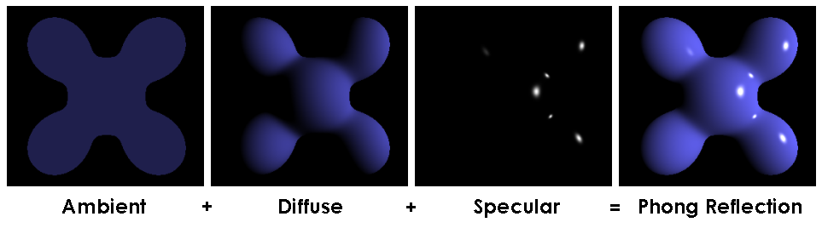
Vrste modela osvetljenja
Local illumination
Svetlo koje posle najviše jednog odbitka dolazi do kamere
Objekti na sceni ne utiču jedni na druge
Global Illumination
U potpunosti matematički opisano pomoću rendering jednačine
Postoje razni algoritmi koji rešavaju ovu jednačinu, sa različitim pretpostavkama ili aproksimacijama
Značajno kompleksniji
U igrama se često izračunavaju offline i čuvaju kao deo geometrije
Ray Tracing in One Weekend - https://raytracing.github.io/
Notes:
One of the simplest kinds of lighting is diffuse lighting, which simply adds a bit of the light color to the native color of the triangle, depending on how it is oriented to the light. When light hits something, the light color is added to the color of the object. This color is typically defined by a material

Slide 38
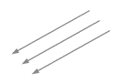
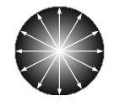

Vrste svetala
Ambijentalno
Nema smer
Ravnomerno osvetljava celu scenu
Usmereno
Beskonačno udaljeno
Tačkasto / Point
Uniformno u svim smerovima počev od određene pozicije na sceni
Intenzitet opada sa kvadratom udaljenosti od izvora
Spot
Osvetljava kupu počev od određene pozicije na sceni
Intenziteta opada sa kvadratom udaljenosti od izvora
Intenzitet opada ka unutrašnjosti kupe

Slide 39
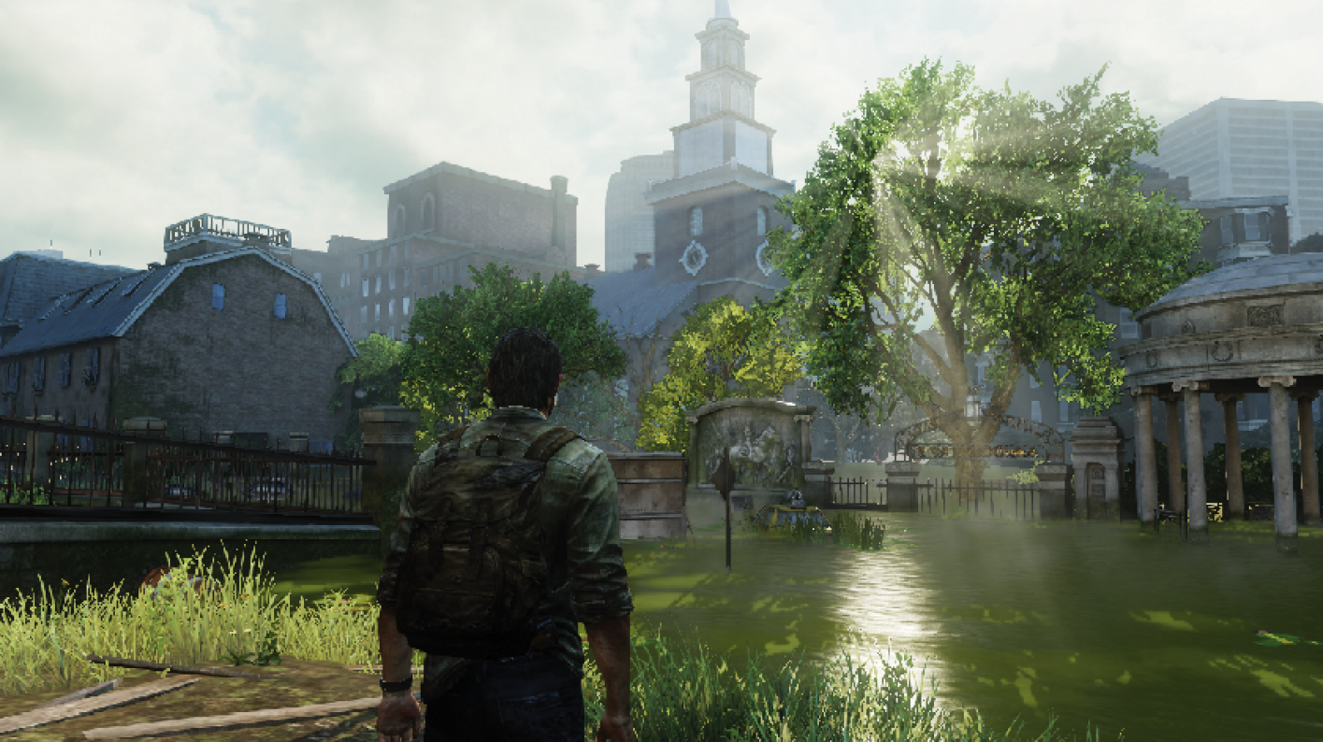
Notes:
Scene from The Last of Us: Remastered (© 2014/™ SIE. Created and developed by Naughty Dog, PlayStation 4) with full lighting.
Jason Gregory. 2014. Game Engine Architecture

Slide 40
Kamera
Nema svrhe prikazivati objekte koji se neće iscrtavati na ekranu
View volume – prostor sa objektima koji se iscrtavaju
Culling - proces eliminacije objekata koji su van kamere
Kamera je opisana pozicijom u svetu, smerom gledanja, kao i matematičkim opisom view volume-a

Slide 41

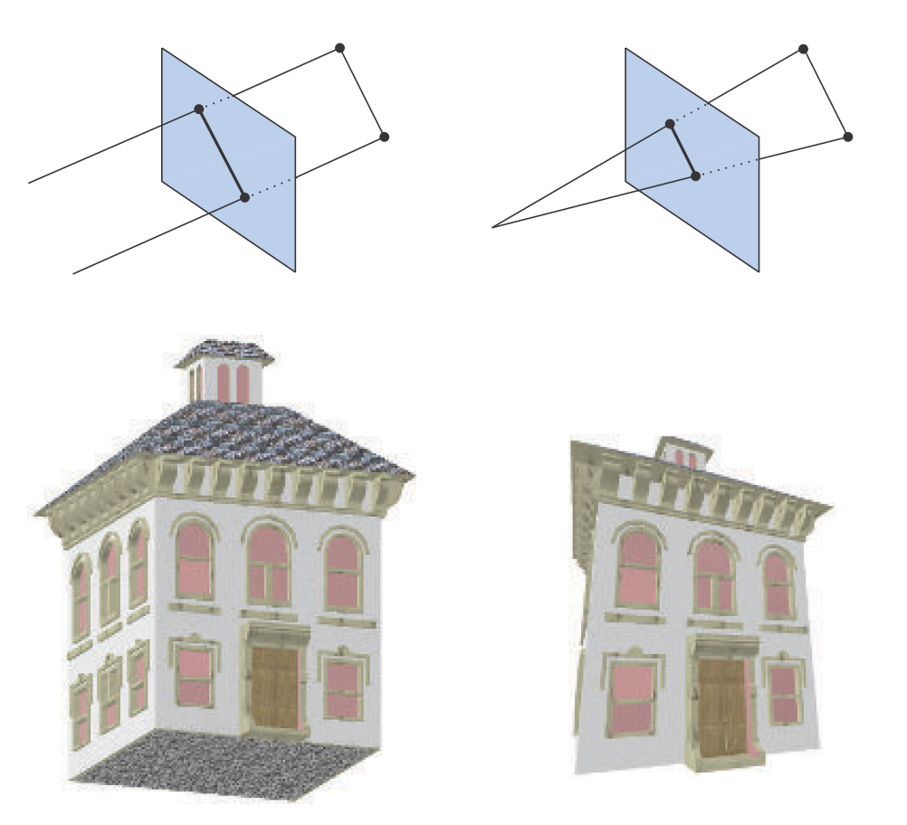
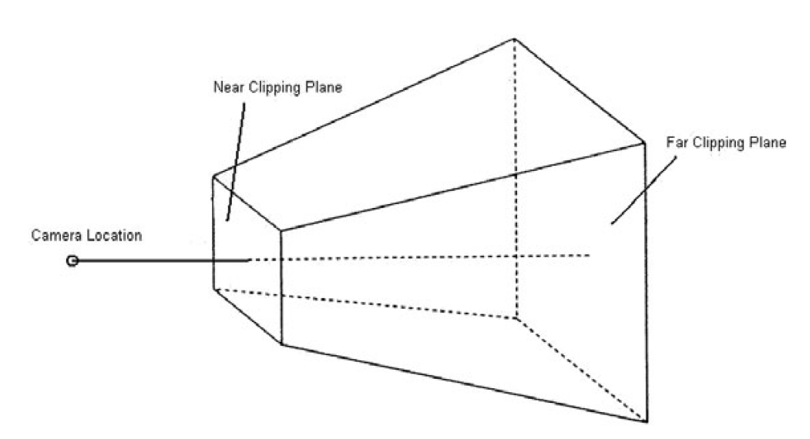
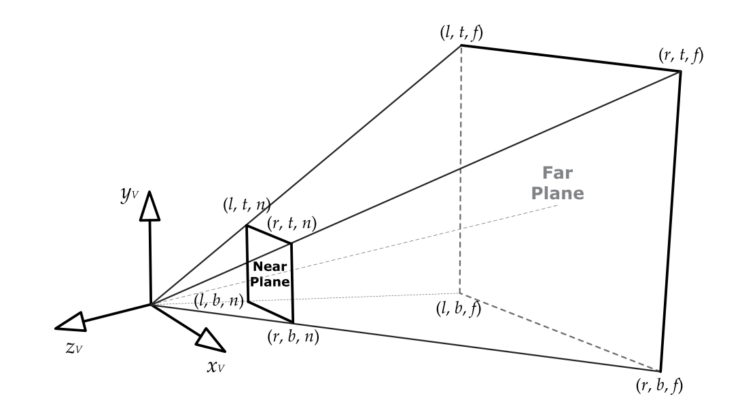
Kamera
Jason Gregory. 2014. Game Engine Architecture
David H. Eberly. 2004. 3D Game Engine Architecture: Engineering Real-Time Applications with Wild Magic
Tomas Akenine-Mller, Eric Haines, and Naty Hoffman. 2018. Real-Time Rendering, Fourth Edition (4th. ed.)

Slide 42
Kamera
Model space - Svaki objekat, kad nastaje u nekom programu ima svoj koordinatni sistem
World space - Kad se objekat postavi u svet, tačke objekta se transliraju, rotiraju i skaliraju
Camera space - Položaj objekata u koordinatnom sistemu kamere
Screen space – Uzevši u obzir aspect ratio i view volume kamere, projektujemo objekte na „senzor kamere“
Notes:
U svom kooridnatnom sistemu, svaki vertex / tačka objekta ima određene koordinate u odnosu na neki koordinatni početak. Može biti centar objekta, ćošak, može biti i nešto potpuno treće
Ove operacije se vrše pomoću transformacionih matrica. Svaki vertex se pomera na položaj u svetu u koji je postavljen, zatim se rotira i skalira u željeni položaj
Kamera ima svoj World matrix i prebacivanje objekta iz World space u Camera space se vrši množenjem vektora položaja vertexa sa inverznom matricom položaja kamere

Slide 43
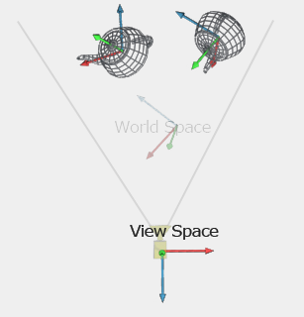
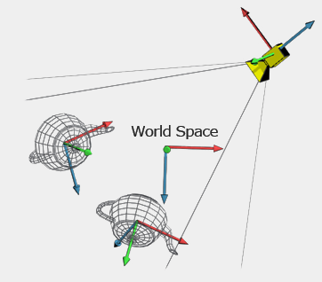
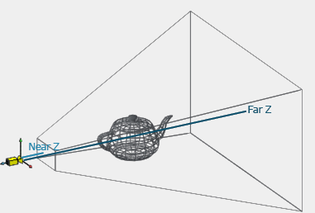
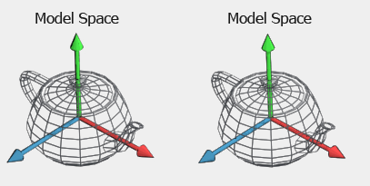
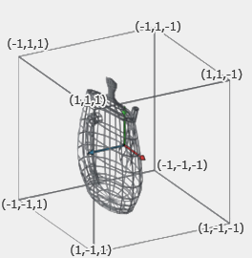
Notes:
Kamera u renderingu je zapravo predstavljena View i Projection matricama koje se prosleđuju vertex shaderu

Slide 44
Frame buffer
Konačna, renderovana slika se smešta u deo memorije koji se zove frame buffer
Hardver koji prikazuje sliku čita sadržaj frame buffera 50/60/120/144 puta u sekundi
Uglavnom postoje bar dva frame buffera koji čine Swap chain
Back buffer
Front buffer
Postoji još bafera koji se koriste za smeštanje podataka tokom procesa renderovanja
Depth buffer
Stencil buffer

Slide 45
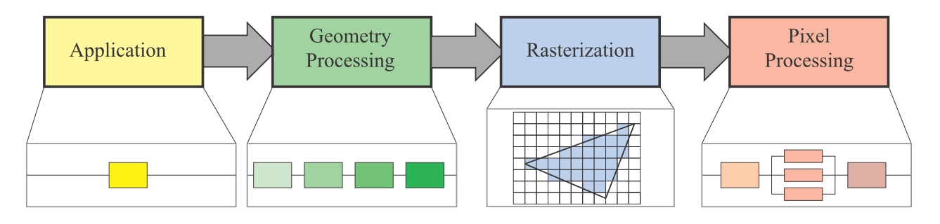
Rendering pipeline
The main function of the pipeline is to generate, or render, a two-dimensional image, given a virtual camera, three-dimensional objects, light sources, and more.
Tomas Akenine-Mller, Eric Haines, and Naty Hoffman. 2018. Real-Time Rendering, Fourth Edition (4th. ed.)
Notes:
Sada sve ovo treba da spojimo u jedno

Slide 46
Application stage
Izvršava se na CPU
Stvari koje utiču na rendering, ali nisu nužno deo renderinga
Kolizije
Animacije
Input
Culling
https://docs.cryengine.com/display/SDKDOC4/Culling+Explained
https://www.gamesindustry.biz/articles/2016-12-07-overview-on-popular-occlusion-culling-techniques
Slanje mesheva i materijala na GPU, konfiguracija shader-a

Slide 47
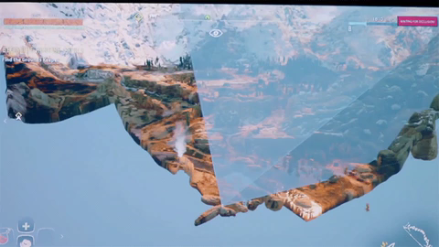
Culling
Notes:
Neke od ovih tehnika se izvršavaju na CPU, neke na GPU

Slide 48
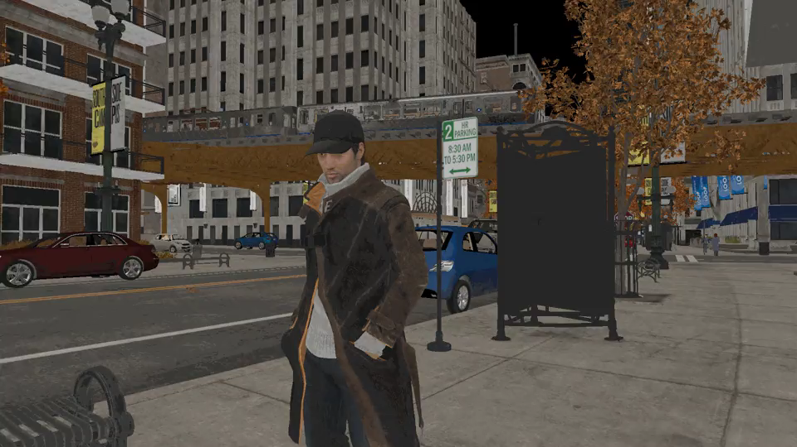
Culling
Notes:
GPU je izuzetno moćan komad hardvera, ali zašto bi se kartica bavila poslom kojim ne mora

Slide 49
Geometry processing
Vertex shader se primenjuje na svaki vertex u paraleli
Model -> World -> Camera -> Screen space projection
Opcioni post-processing
Rasterization
Trougao se rastavlja na fragmente i svaki fragment predstavlja jedan piksel na ekranu
Pixel shader se primenjuje na svaki fragment u paraleli
Izlaz je boja koja će se upisati u frame buffer i predstavlja boju jednog piksela
Notes:
Skinning, lightning; Post-processing: Culling, Clipping, Tesselation. Čak i neka proceduralna animacija (trava, lišće, voda)
U slučaju multi sample AA, svaki fragment odgovara delu jednog piksela

Slide 50
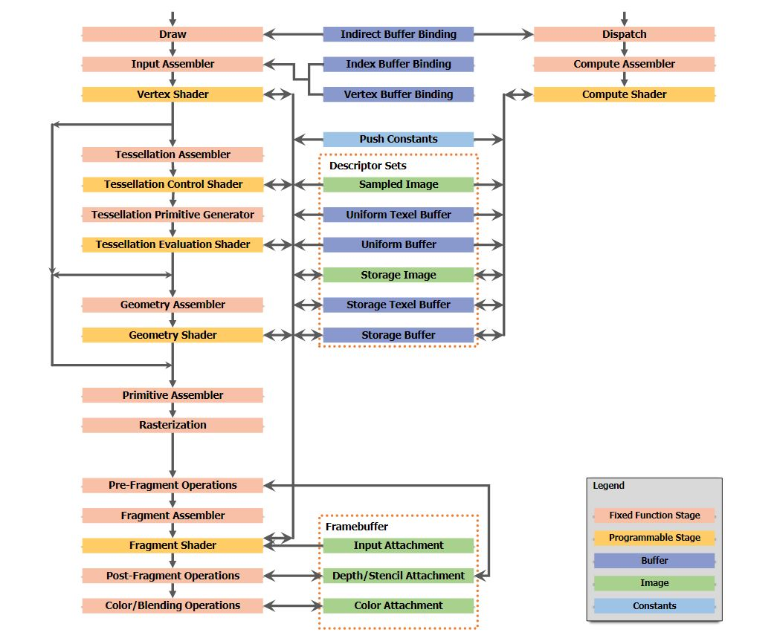
I Am Graphics And So Can You :: Part 2

Slide 51

Fully-procedural sea surface computing. without textures.
https://www.shadertoy.com/view/Ms2SD1

Slide 52
Rendering API
Nivo apstrakcije između drajvera i korisničkog programa
OpenGL, DirectX 11
Vulkan, DirectX 12, Metal – high performance, state of the art
Različitih nivoa kompleksnosti za programiranje
Za multiplatformski razvoj je potrebno imati nivo apstrakcije iznad Rendering API, tako da u compile-time ili u runtime možemo da biramo koji Rendering API želimo

Slide 53

Rendering API
https://www.youtube.com/user/TheChernoProject

